Slide 1
Task 1
P.V.S.S. Ramateja
21A31A4357
CSE-AI

Slide 2
Sequence of Practical STEP-1 : Create a VPC & 4 Subnets in VPC STEP-2 : Create a Internet Gateway then Attach to VPC STEP-3 : Create Route Table and connect it to Internet Gateway STEP-4 : To create multiple instances there are 2 ways : 1.To increase the number of instances while creating the EC2 2.Create Template & Create Auto Scaling Group for multiple instances (2nd way is best for this scenario) STEP-5 : Create a template based on requirement & then create Auto Scaling Group STEP-6 : After ASG creation , Multiple instances will be created automatically STEP-7 : Create IAM users for each instance Create IAM users for each instance. STEP-8 : Give AmazonEC2FullAccess & AmazonS3FullAccess permissions to each IAM

Slide 3
price

Slide 4
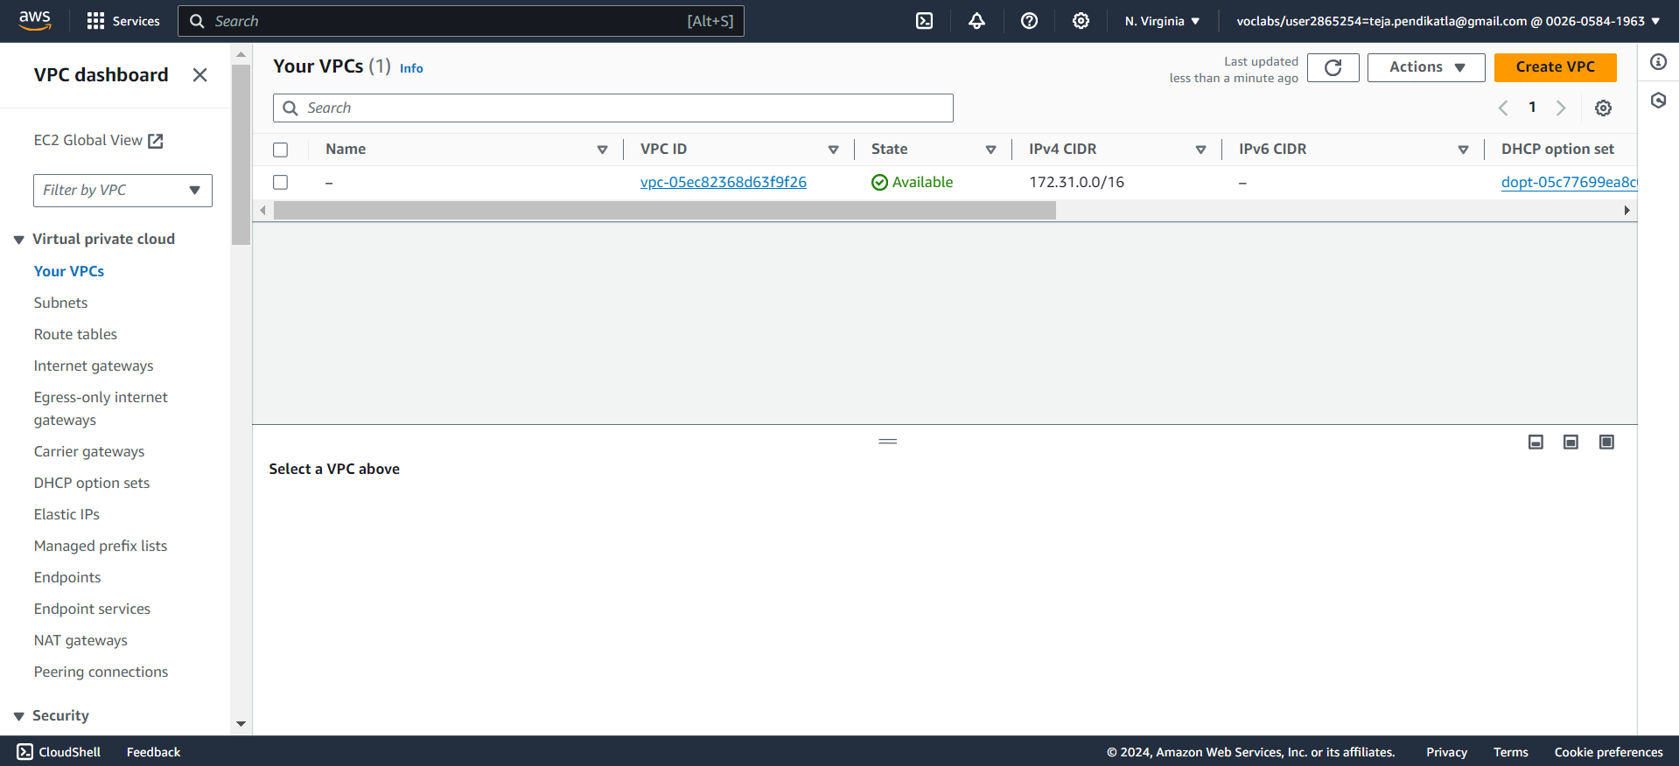
1.Create VPC

Slide 5
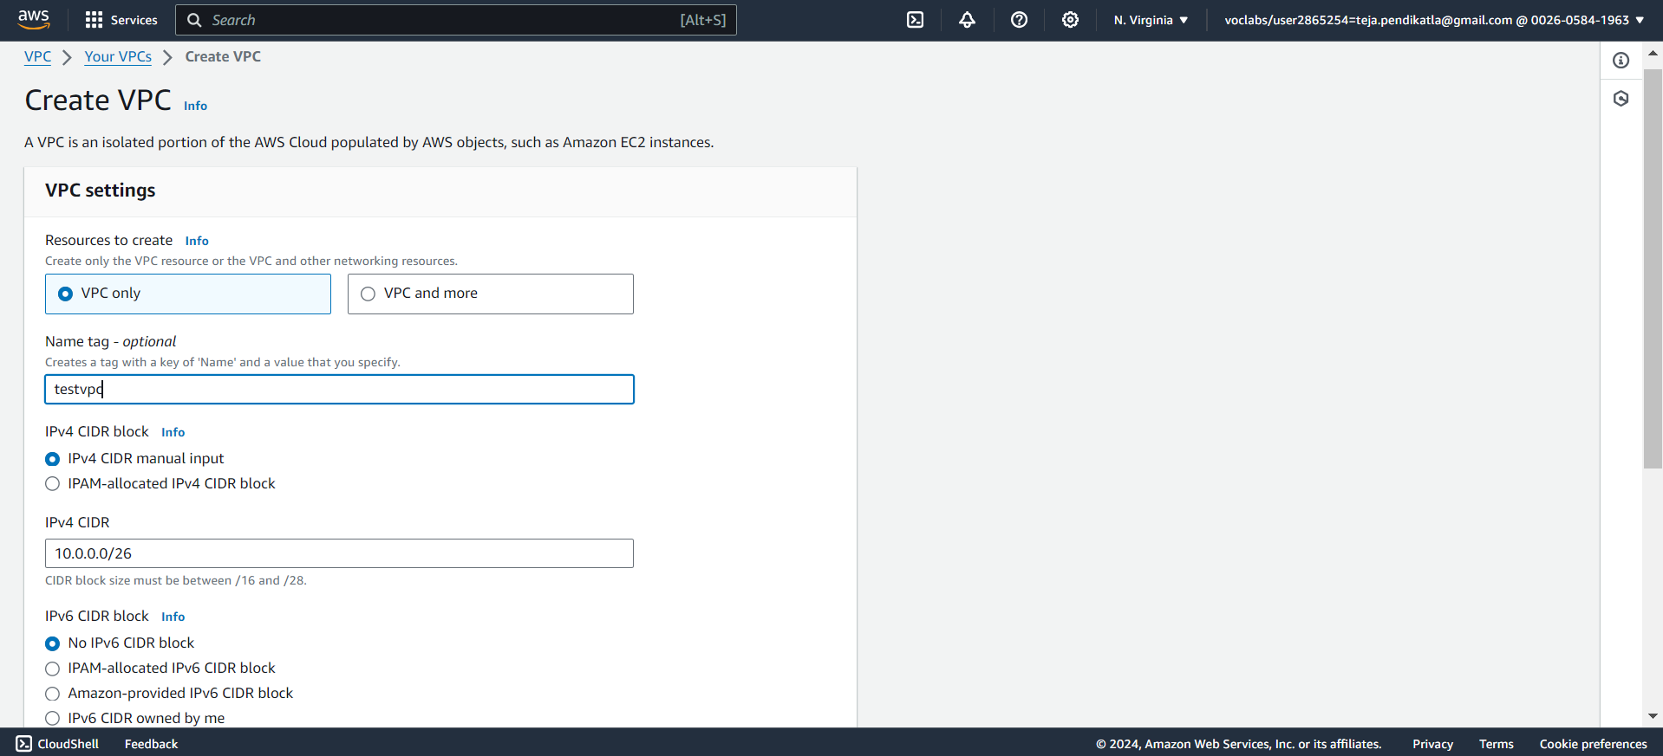
2.Give Name for VPC and give IPv4 CIDR

Slide 6
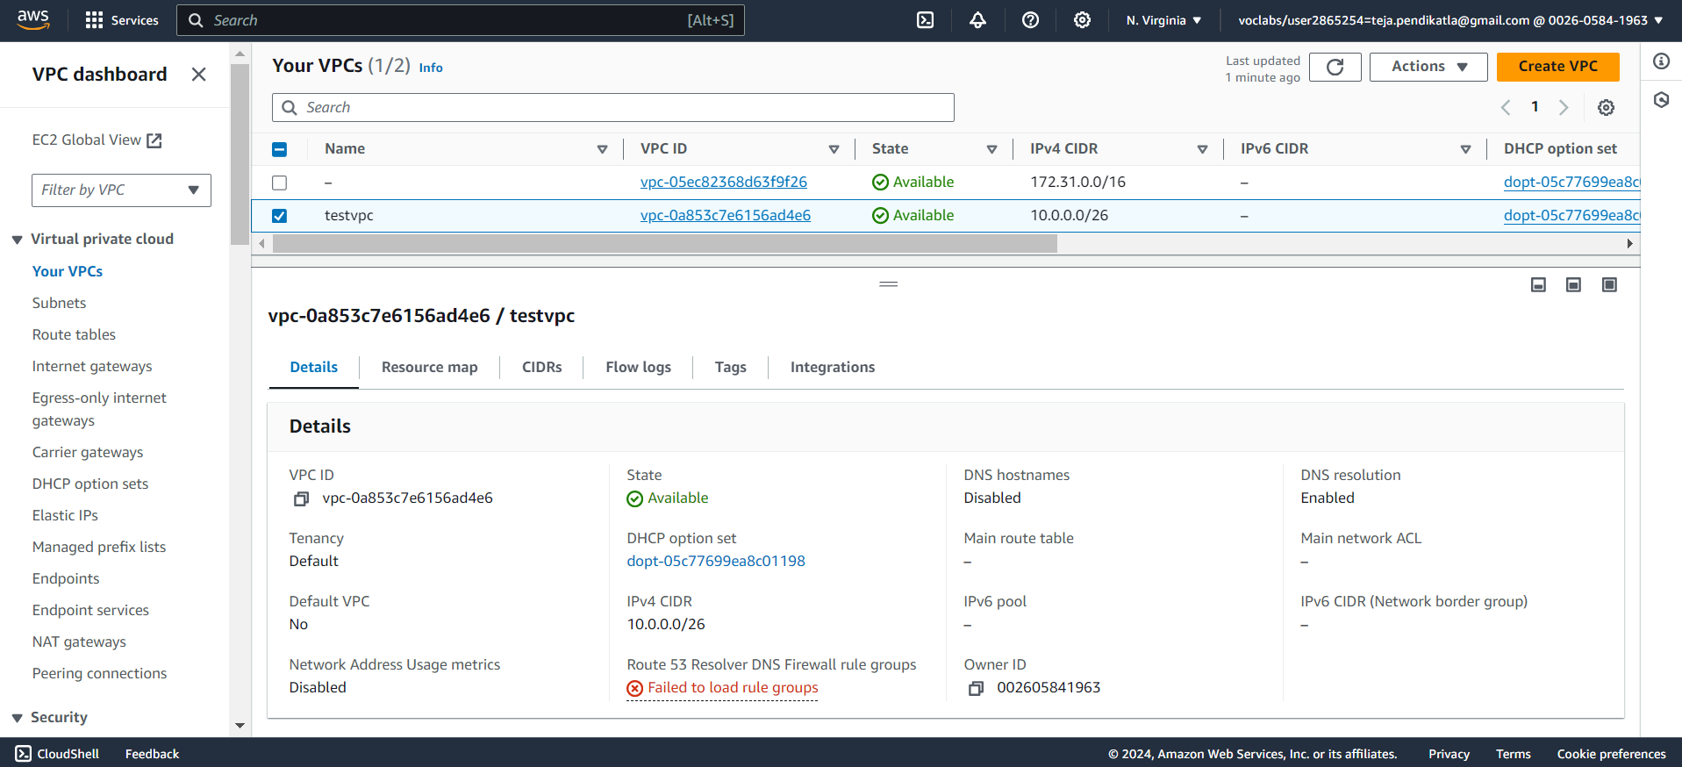
3.VPC is created

Slide 7
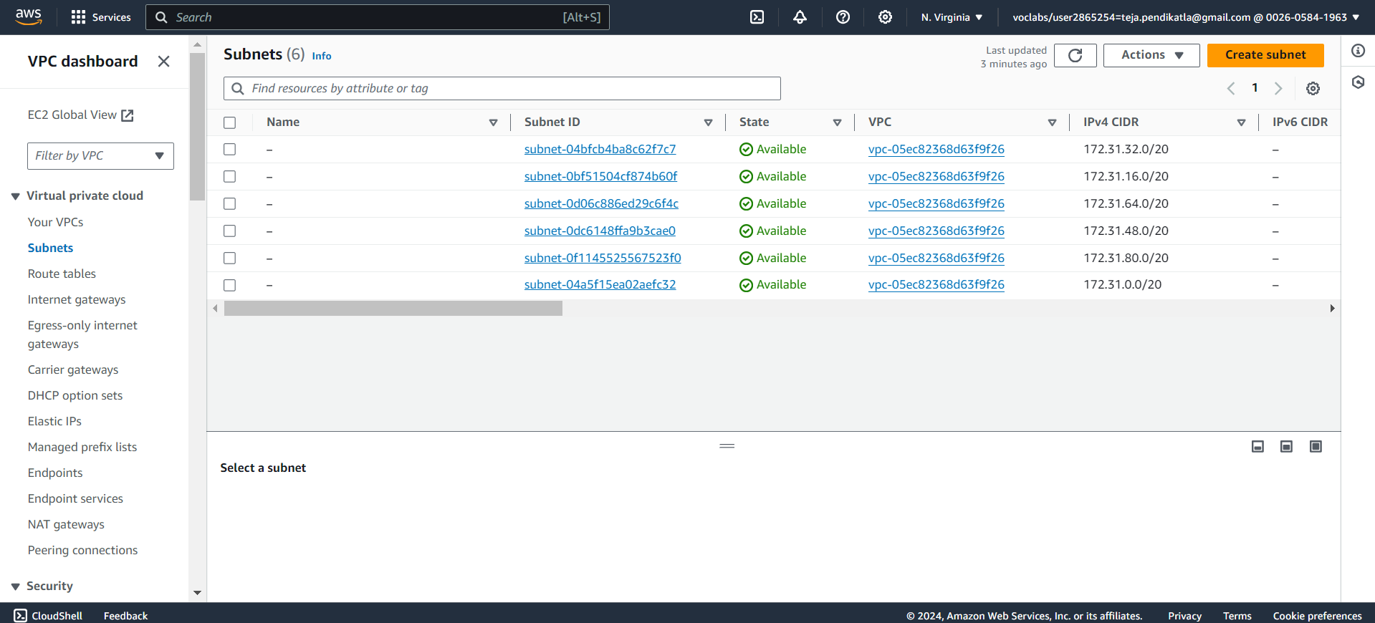
4.Create Subnet – 2 Public , 2 Private

Slide 8
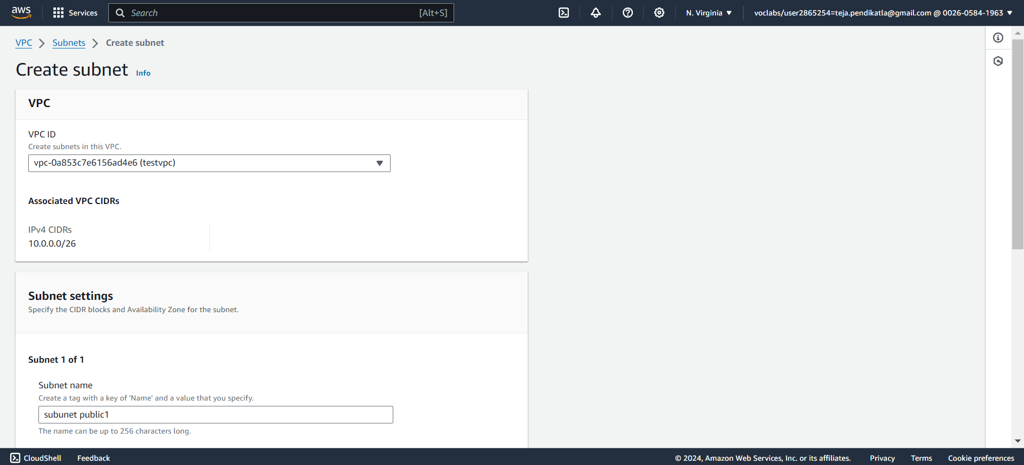
5.Select VPC for each Subnet

Slide 9
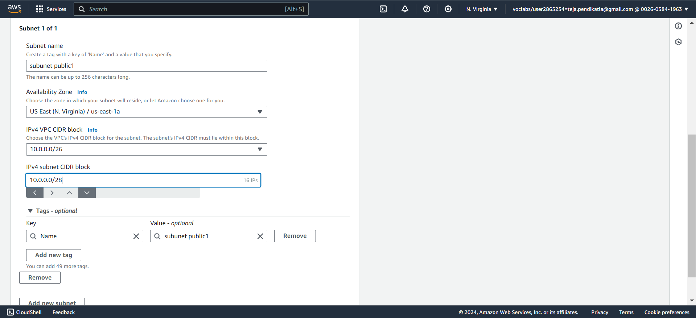
6.Create Subnet Public 1

Slide 10
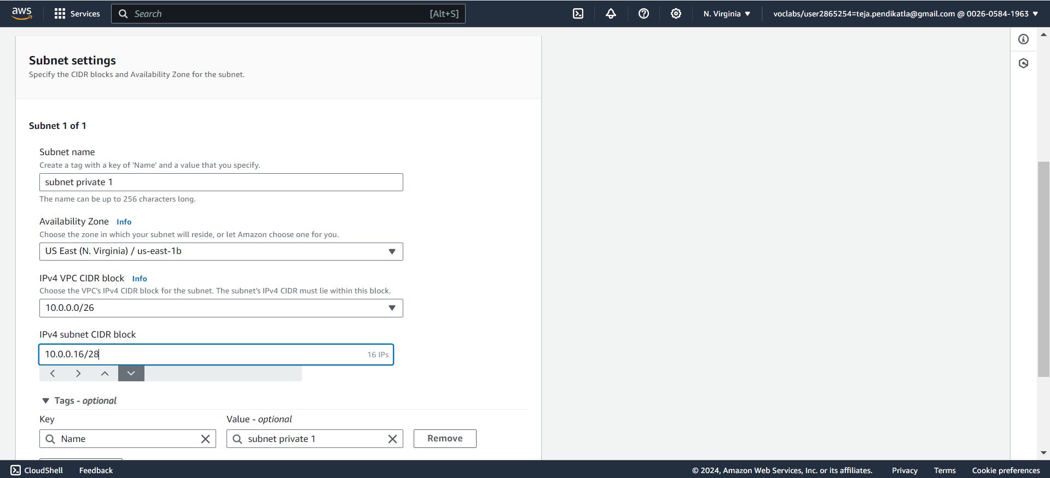
7.Create Subnet Private 1

Slide 11
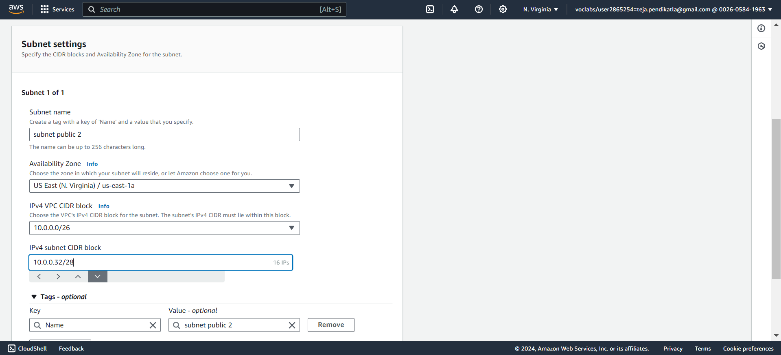
8.Create Subnet Public 2

Slide 12
9.Create Subnet Private 2

Slide 13
10. 4 Subnets Created in VPC

Slide 14
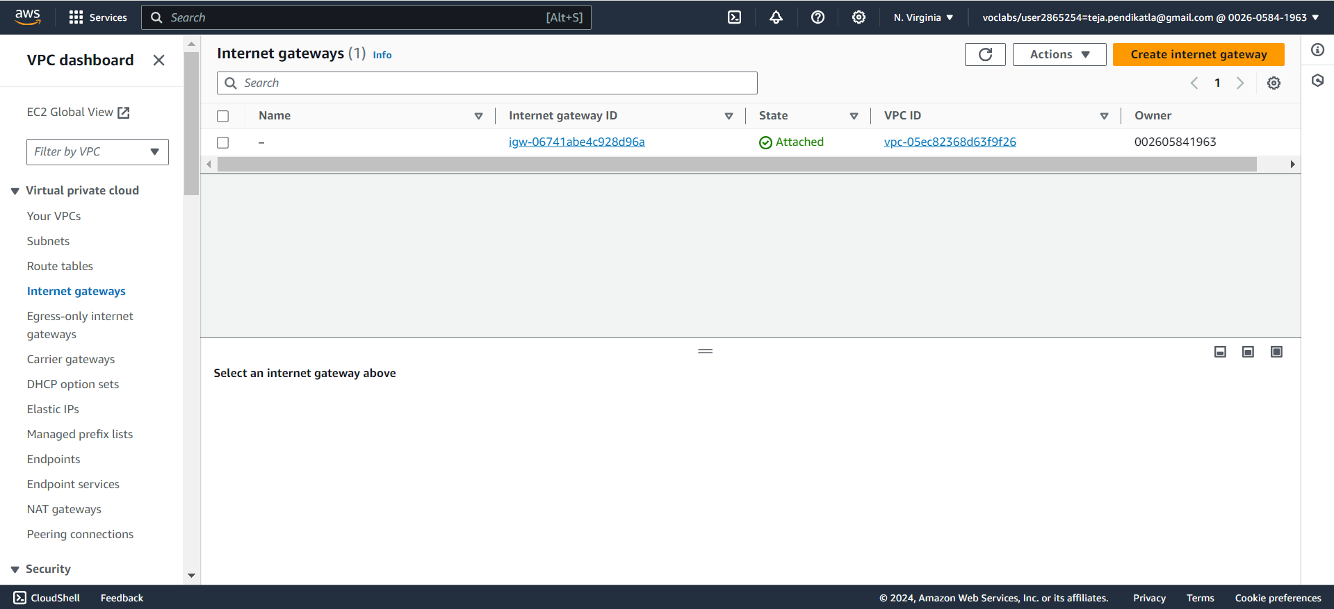
11. Create Internet Gateway

Slide 15
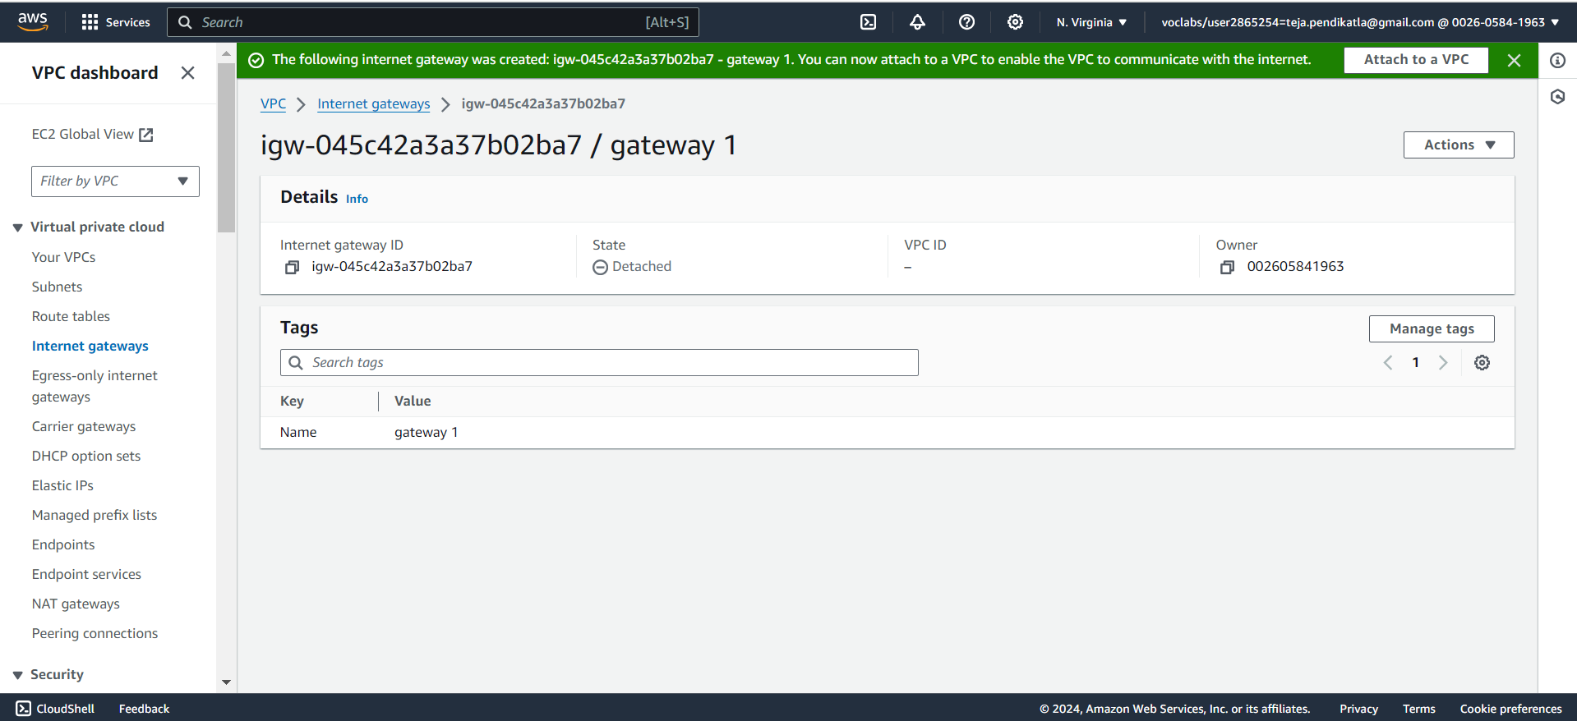
12. Click on Attach to VPC

Slide 16
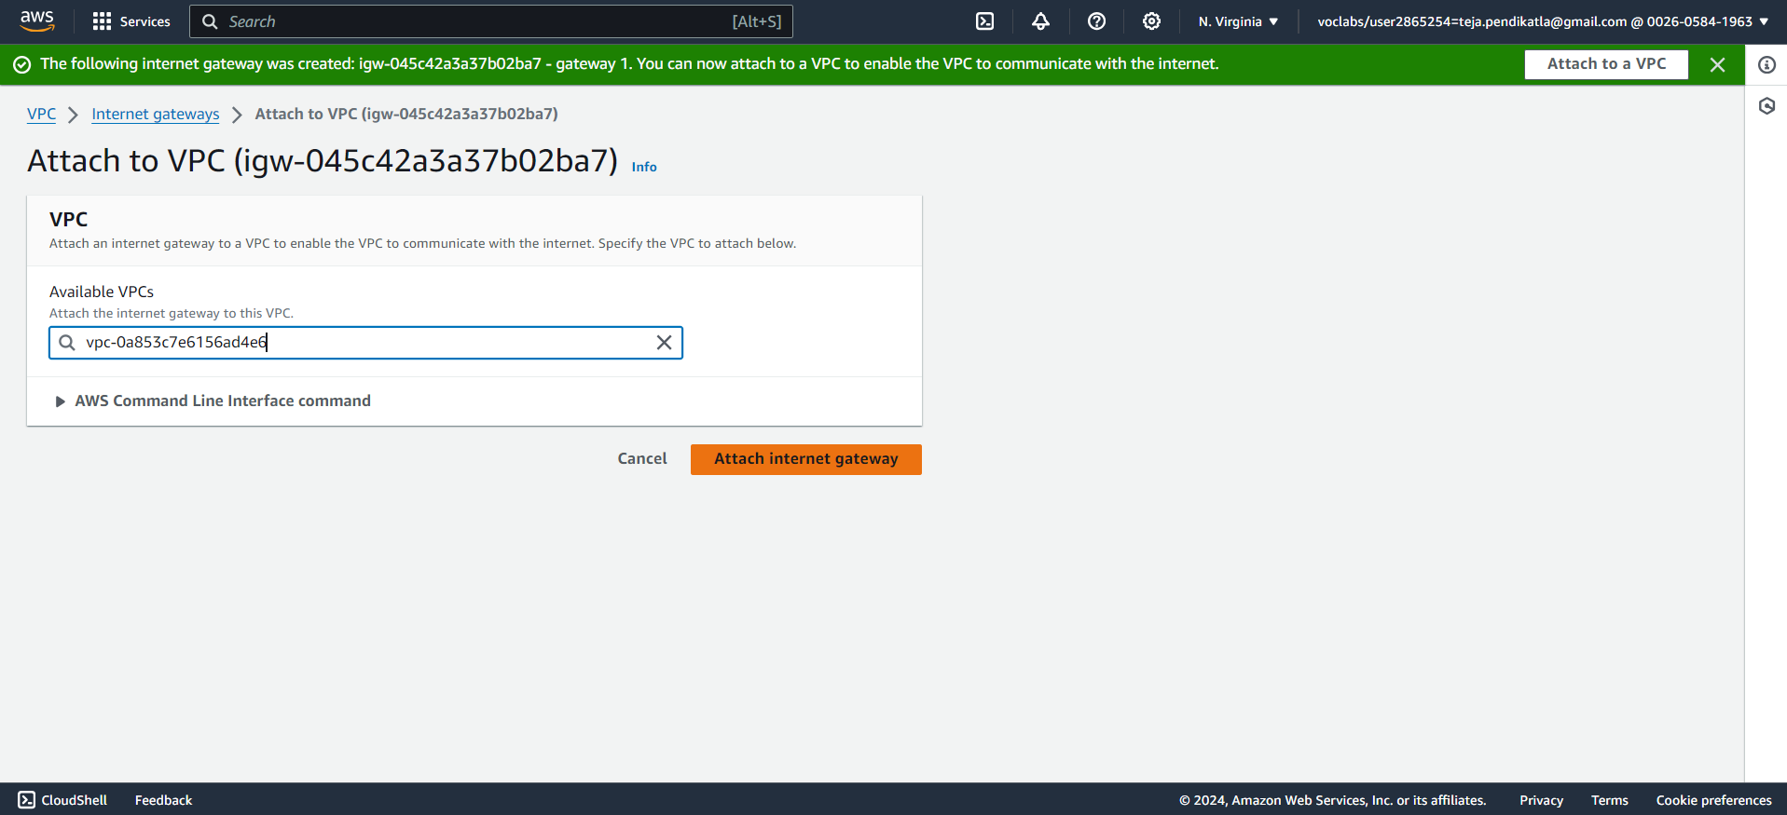
13. Attach IGW to VPC

Slide 17
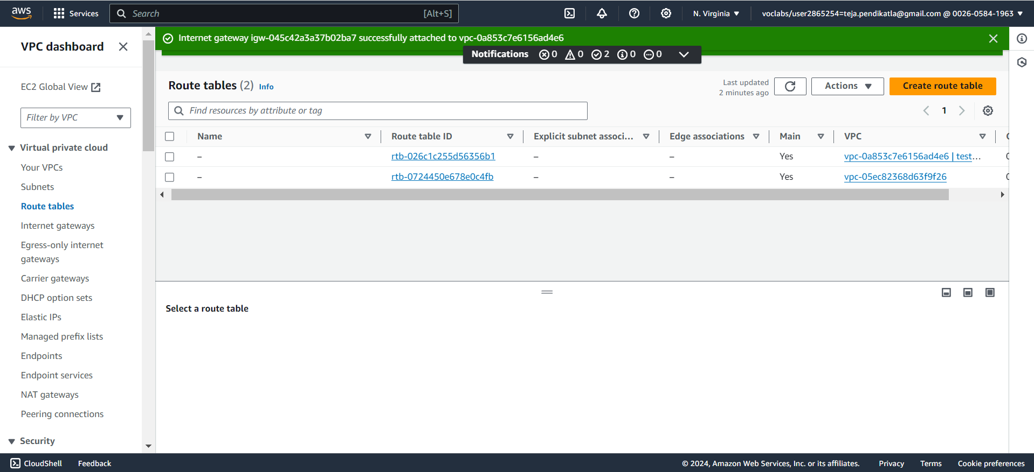
14. Internet Gateway created and attached to VPC

Slide 18
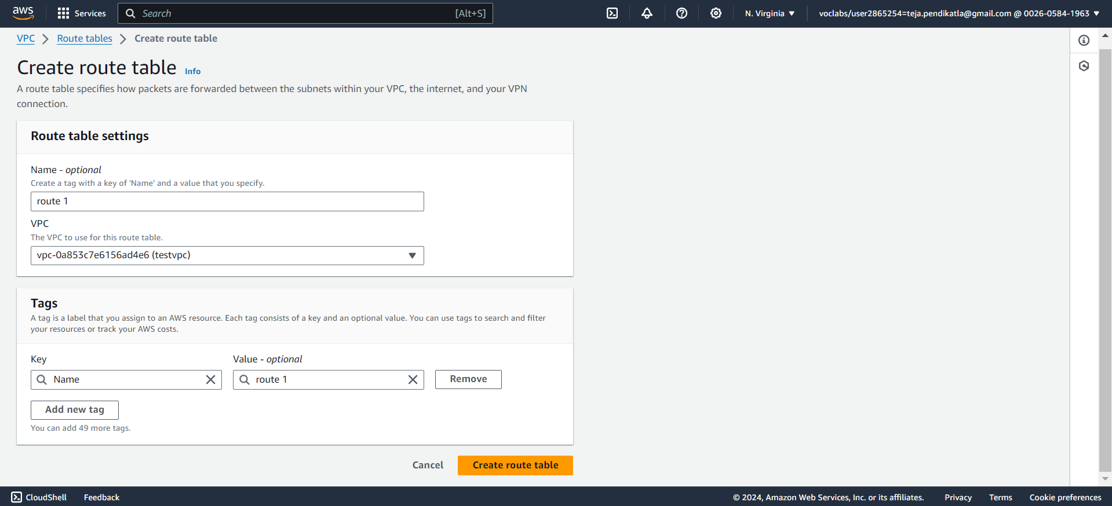
15. Create Route Table

Slide 19
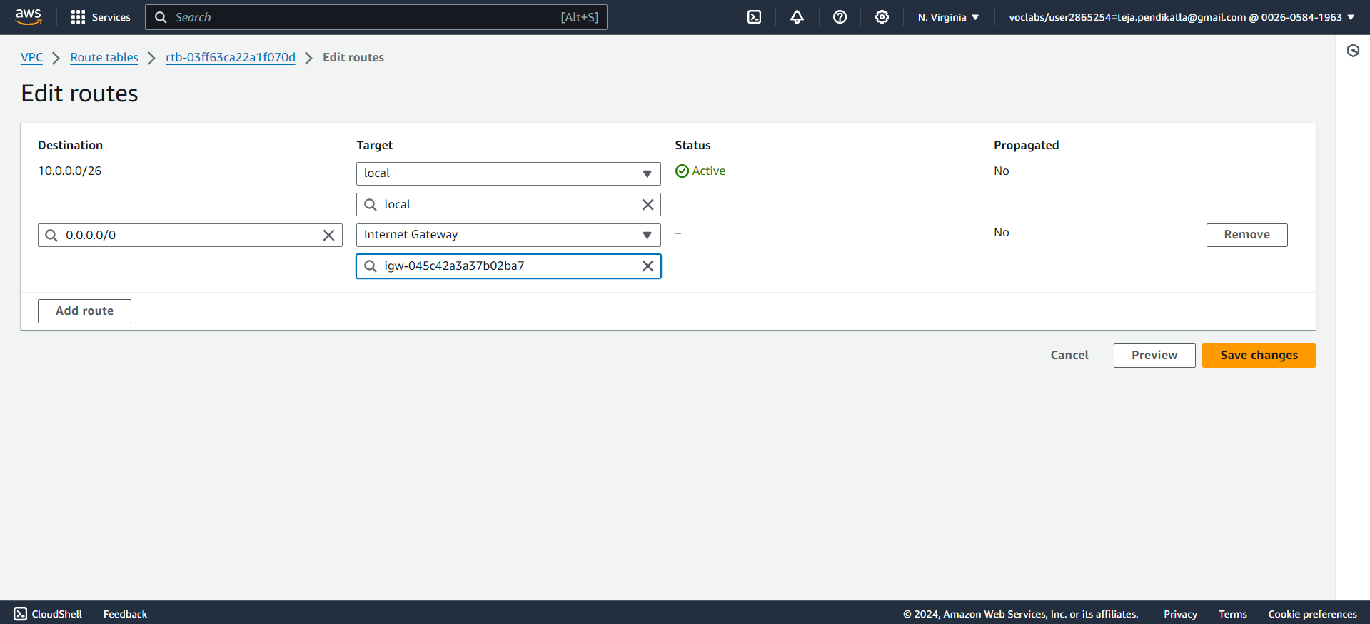
16. Connect Route table to IGW

Slide 20
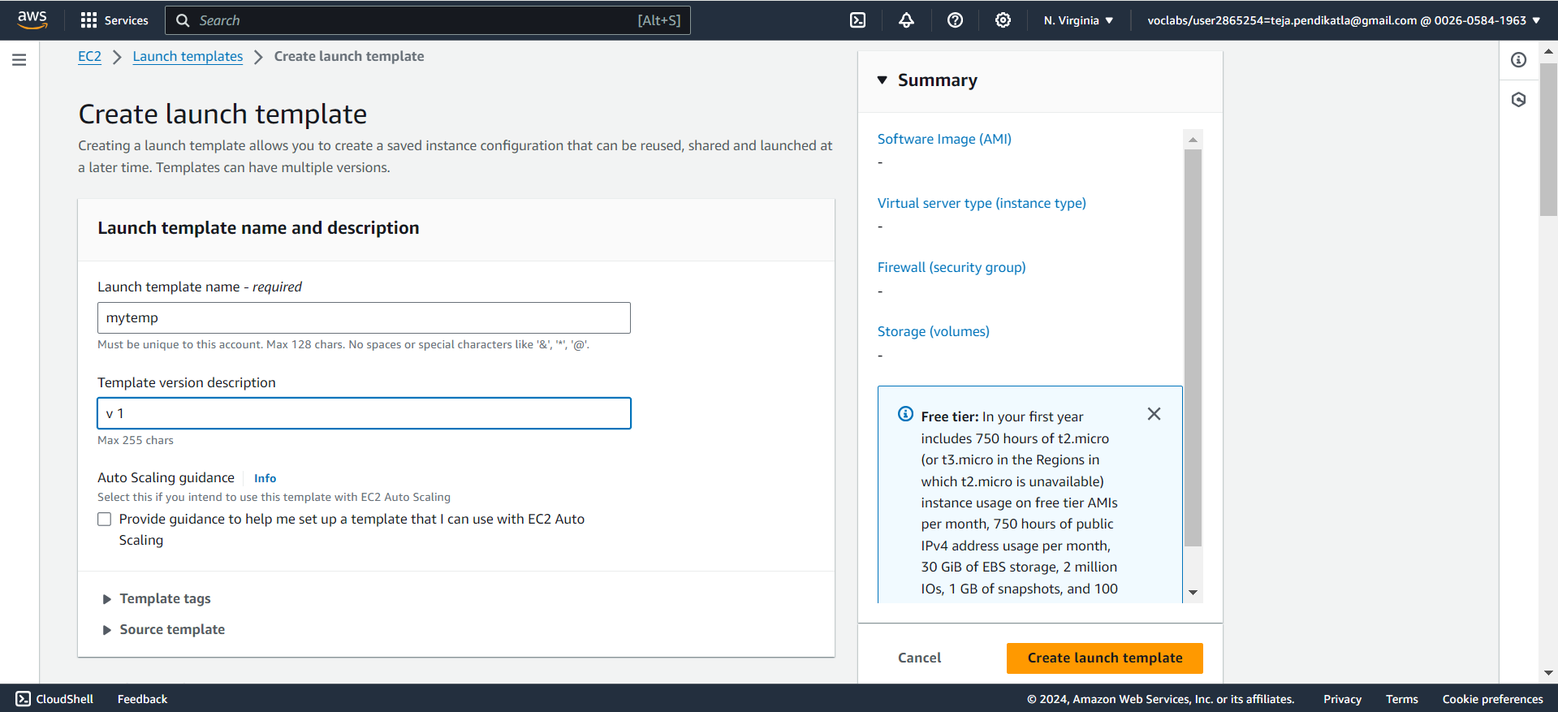
17. Launch Template

Slide 21
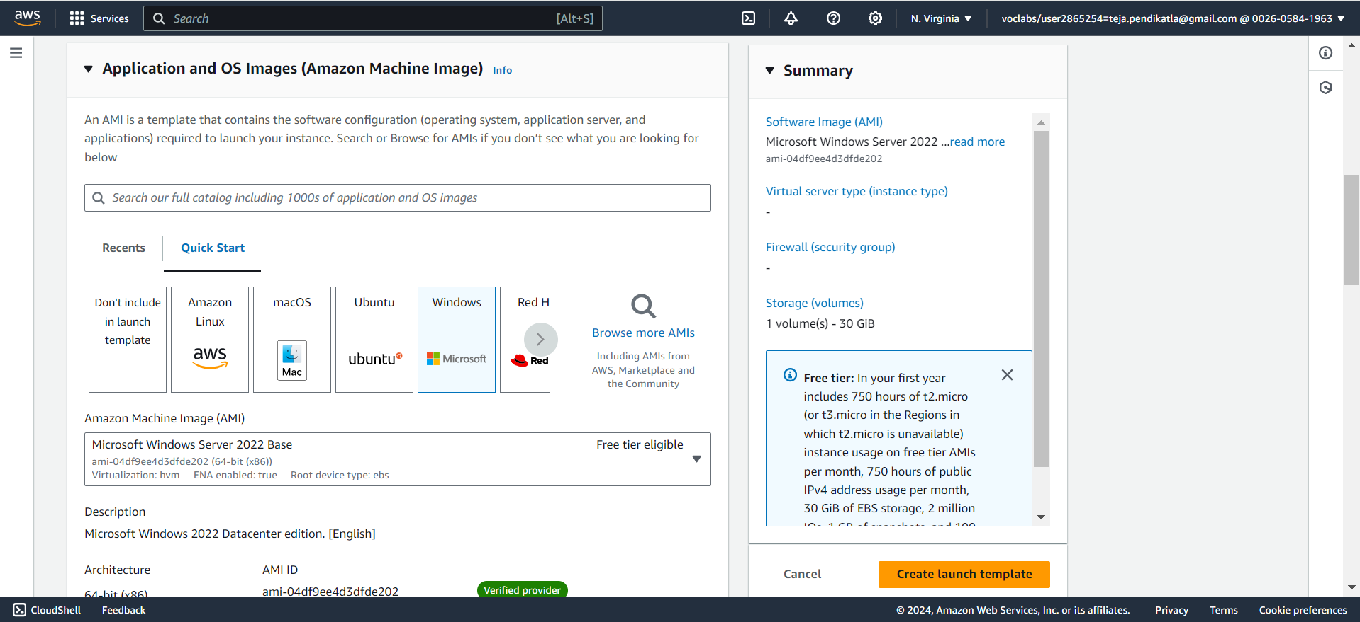
18. Click on Microsoft

Slide 22
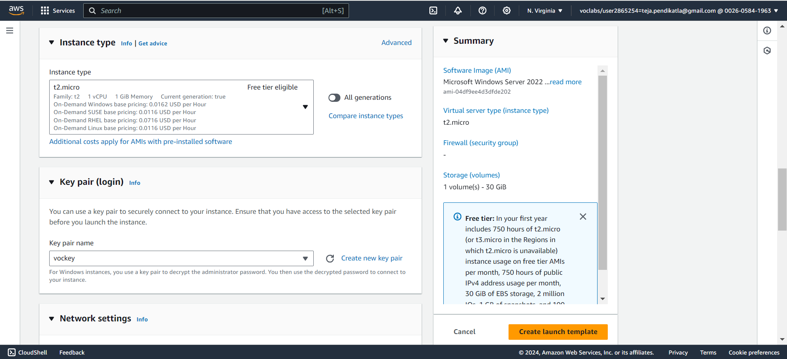
19. Select Instance and Key pair

Slide 23
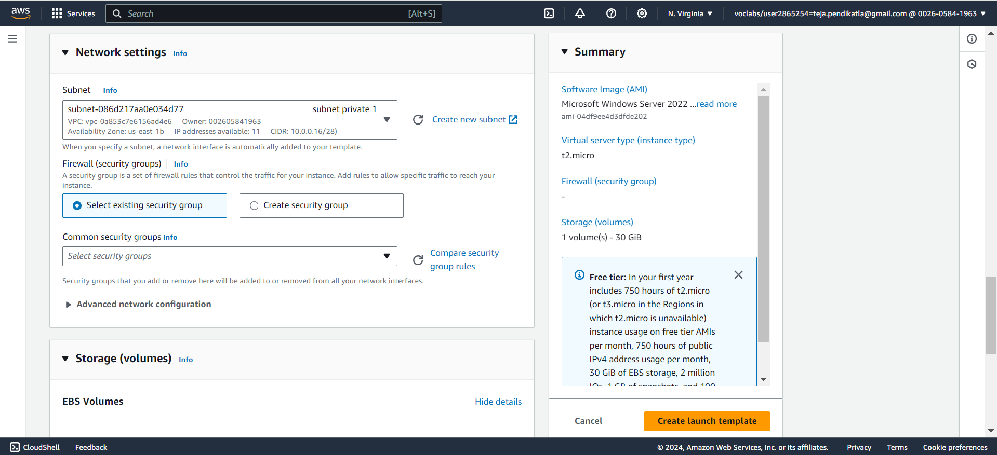
20. Select Subnet

Slide 24
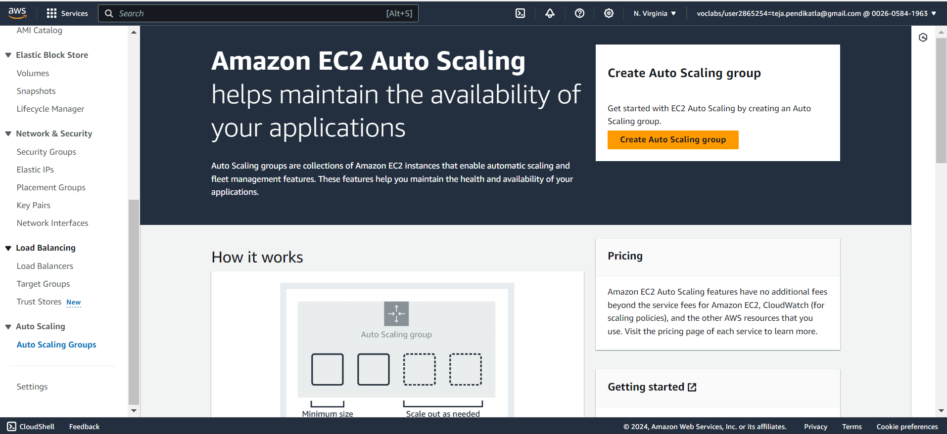
21. Create Auto Scaling Group

Slide 25
22. Choose Template

Slide 26
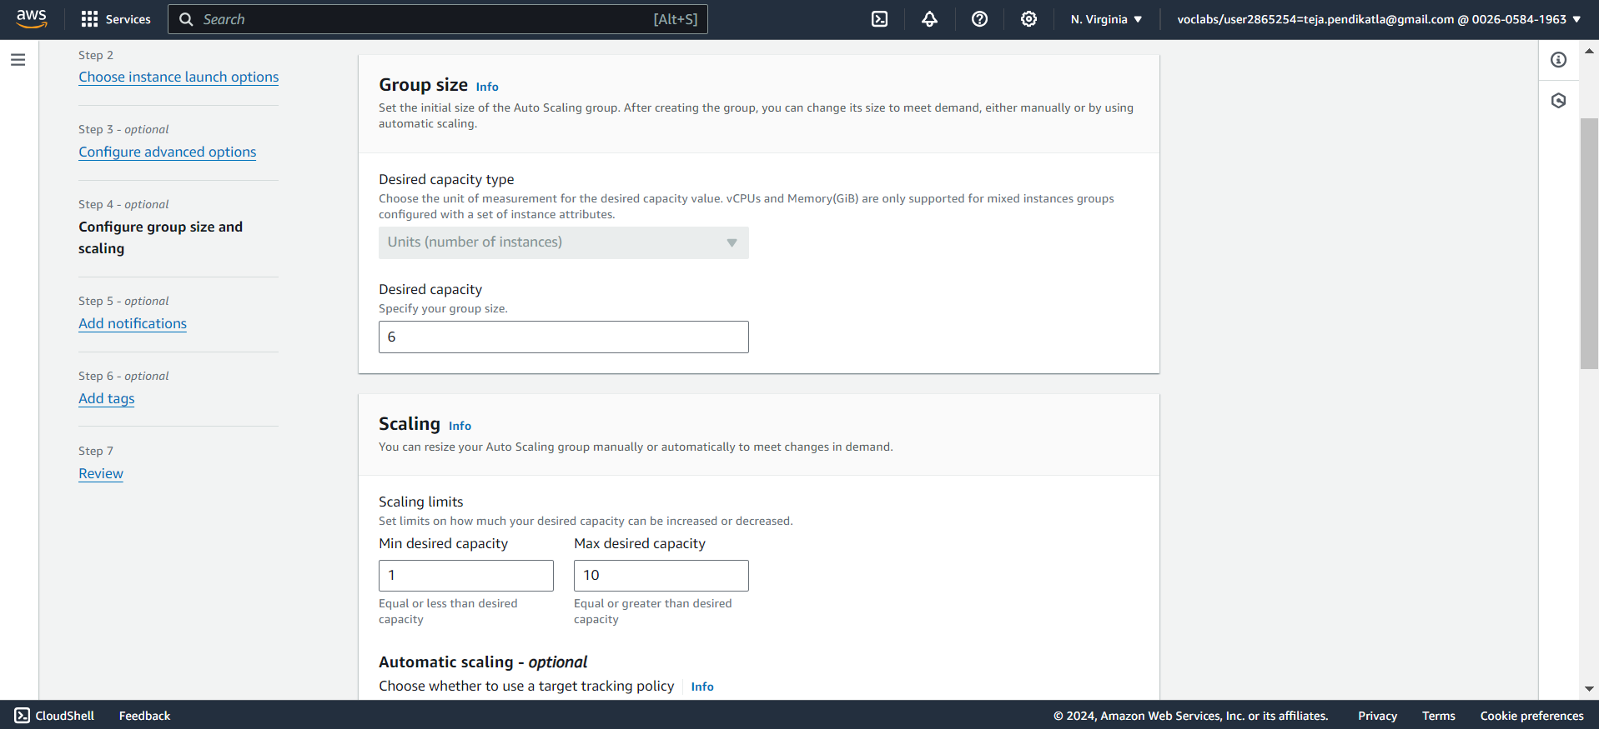
23. Enter number of instances to be created

Slide 27
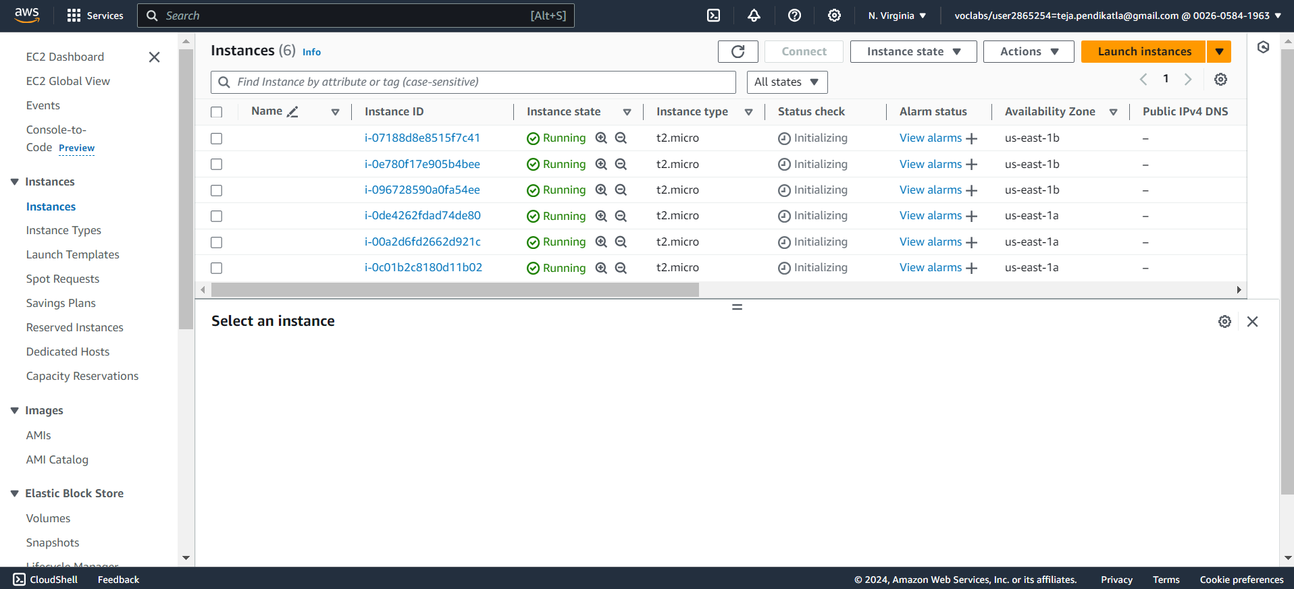
24. 6 Instance are created

Slide 28
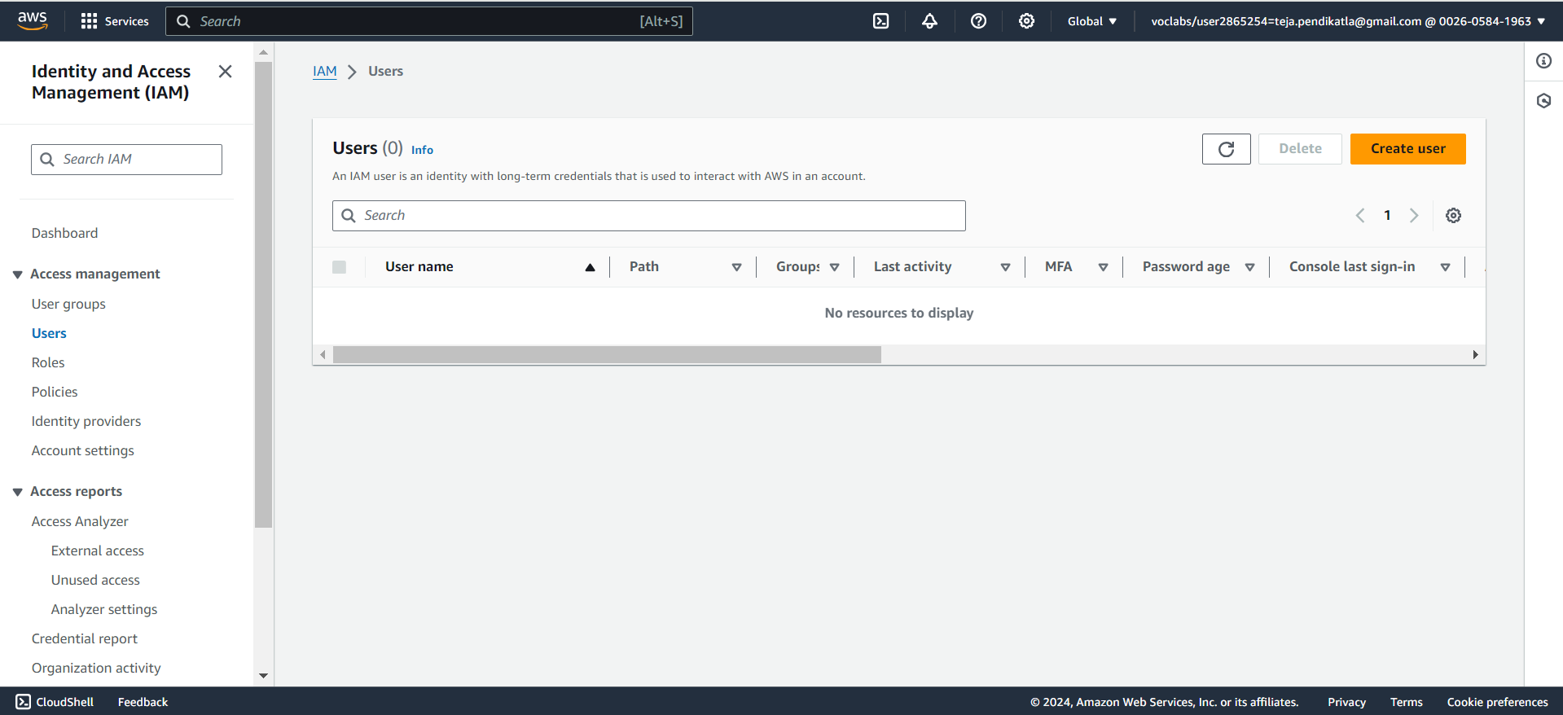
25. Create IAM user - 6

Slide 29
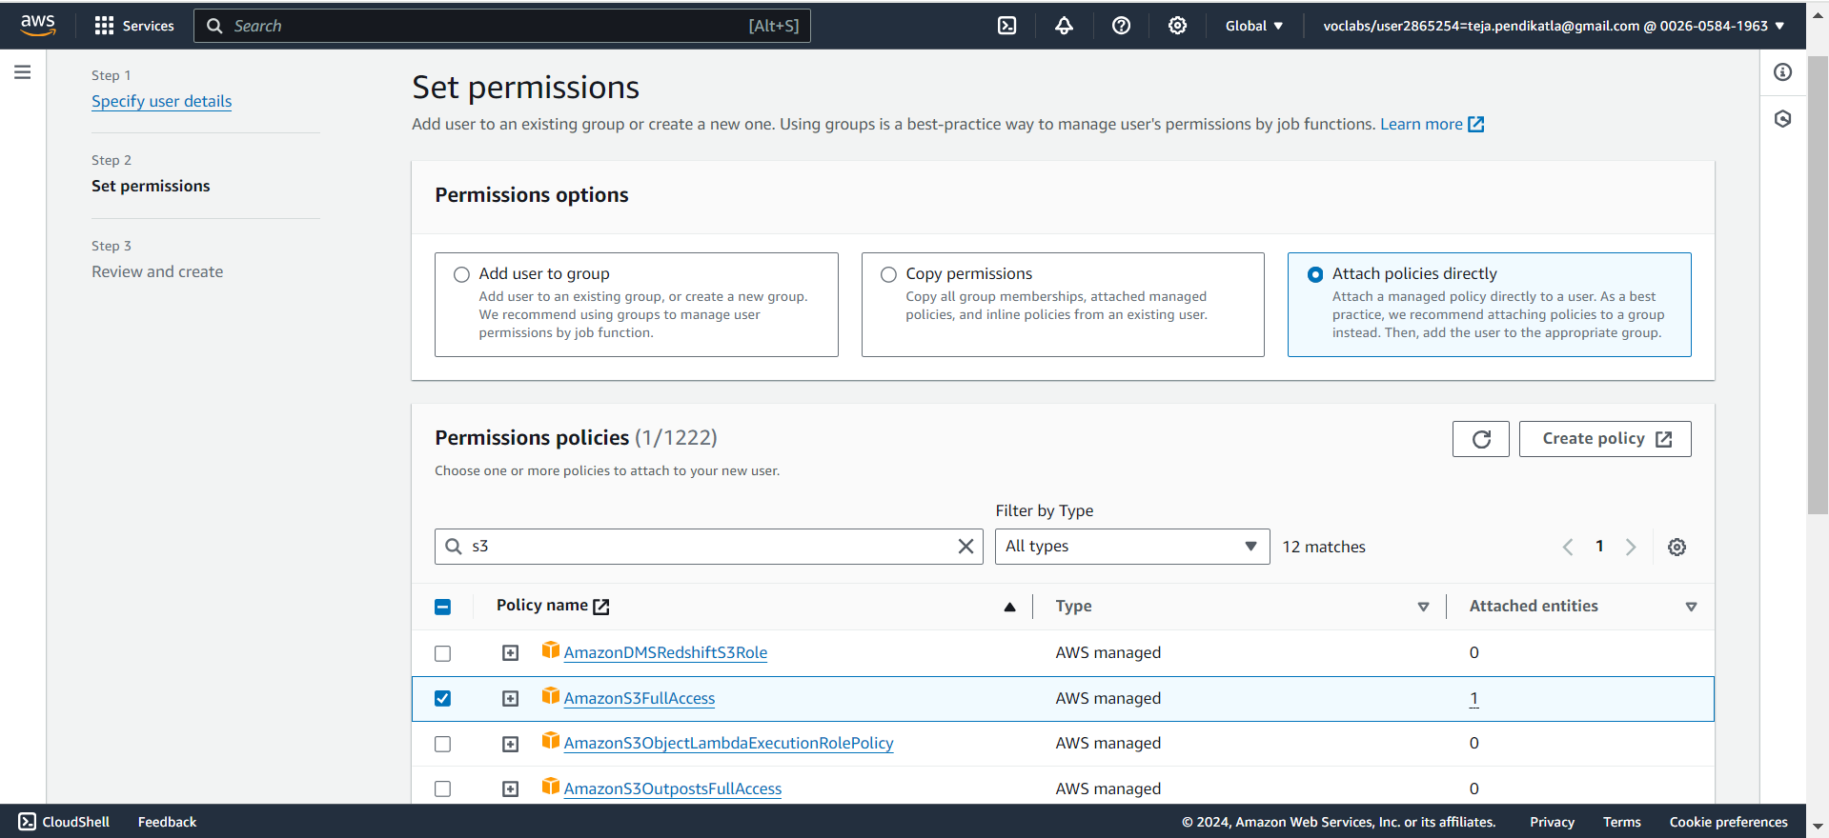
26. Attach Policy to IAM user

Slide 30
27. AmazonS3FullAccess Permission is given to IAM

Slide 31
To Host my application and website in future? Amazon S3 (Simple Storage Service)​ Benefits:​ Cost-effective for static websites (HTML, CSS, JavaScript).​ Scalable and highly available.​ Built-in redundancy and durability.​ Easy to configure and manage.​ Use Cases:​ Hosting static websites and single-page applications (SPAs).​ Serving static content like images, videos, and documents.​ ​ ​

